Slide 1
Deep Team Project Fall 2021
Mentor: Michael Kelley
Team: Daniel Li, Calvin Aberg
Predicting Stock Prices

Slide 2
Roadmap
Background/Motivation
Visualizations
Model

Slide 3
Introduction: Importance
Real World Impact
Relates to other fields
Employment Numbers
Retirement goals
Political approval ratings

Slide 4
Introduction: Motivation
Large and Available
Affects almost everyone
Interesting findings

Slide 5
Introduction: The Data Set
Data points (Over 1 million)
Not every stock contained all data points
Includes Stocks from NYSE, NASDAQ, and AMEX
Small Market Cap - Large Market Cap
Sourced from CNN Money and Yahoo Finance via Kaggle
Sample data point:

Slide 6
Visualizations

Slide 7
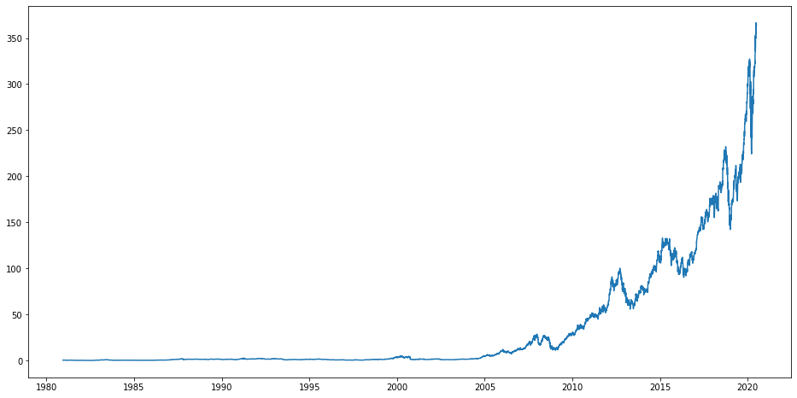
AAPL Price Over Time
Closing price
From 1980s

Slide 8
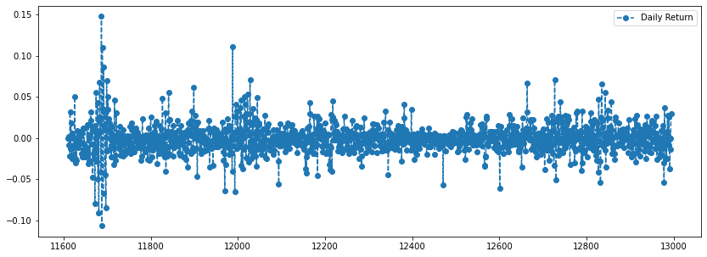
AAPL Daily Return

Slide 9
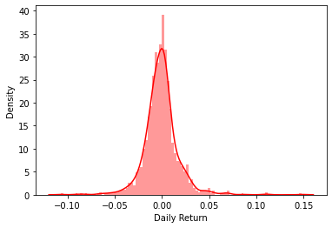
AAPL Daily Return - Histogram

Slide 10
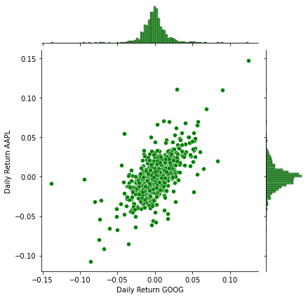
AAPL Daily Return vs. GOOG Daily Return

Slide 11
Our Model

Slide 12
Explanation of LSTM Model
Long Short Term Memory Model
Recurrent Neural Network Model
Keeps information about the past for differing amounts of time

Slide 13
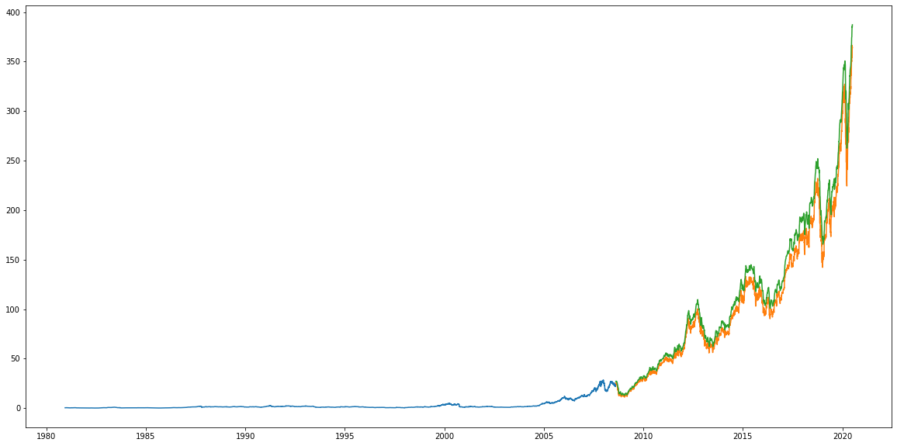
AAPL Price Predictions: RMSE = 12.75

Slide 14
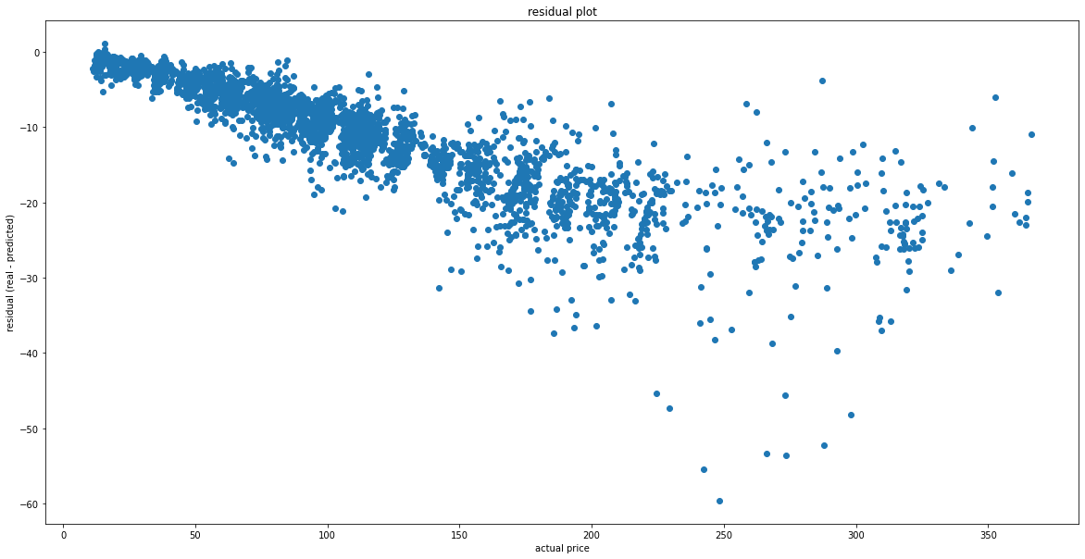
AAPL Residual Plot

Slide 15
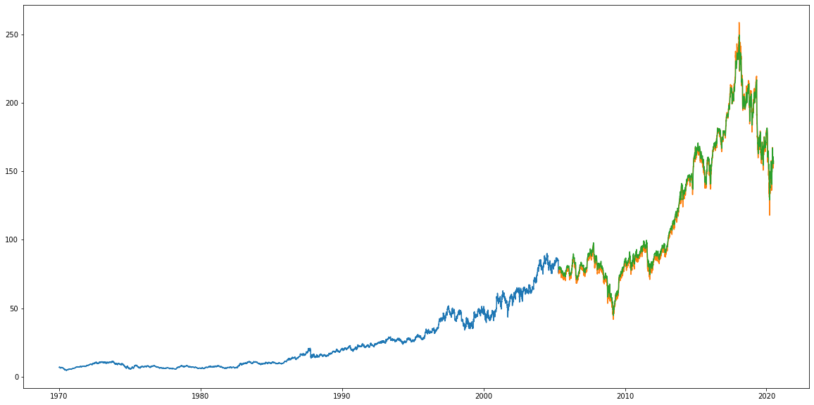
3M Price Predictions: RMSE = 2.94

Slide 16
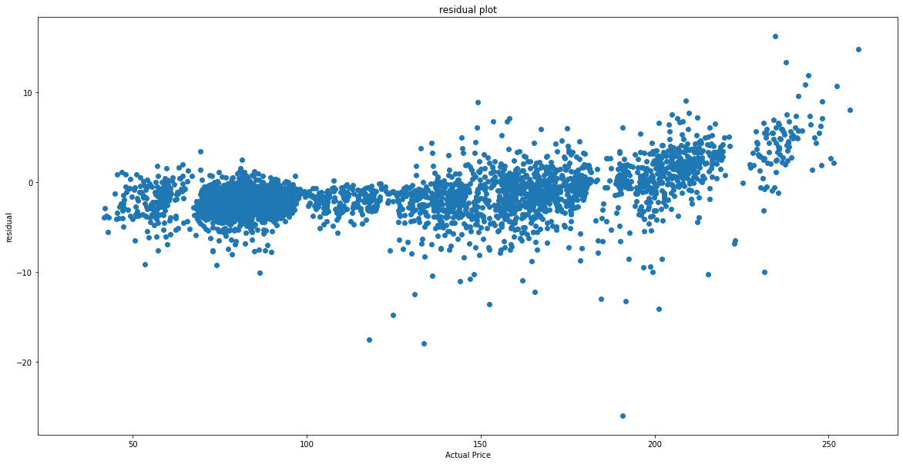
3M Residual Plot
Notes:
We can see here that our deviations in price across the board are much tighter and accurate.

Slide 17
Results/Impact

Slide 18
The Prediction of Stocks is Influential and Lucrative
Prediction within low error is heavily sought after
Complex models serve to improve prediction
Utilizing these models can be lucrative, useful

Slide 19
Summary
Introduction and Importance
Visualization and Analysis
Model Predictions
Results and Importance

